Slide 1
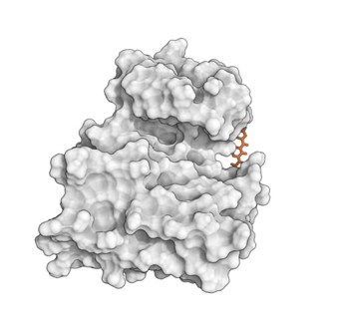
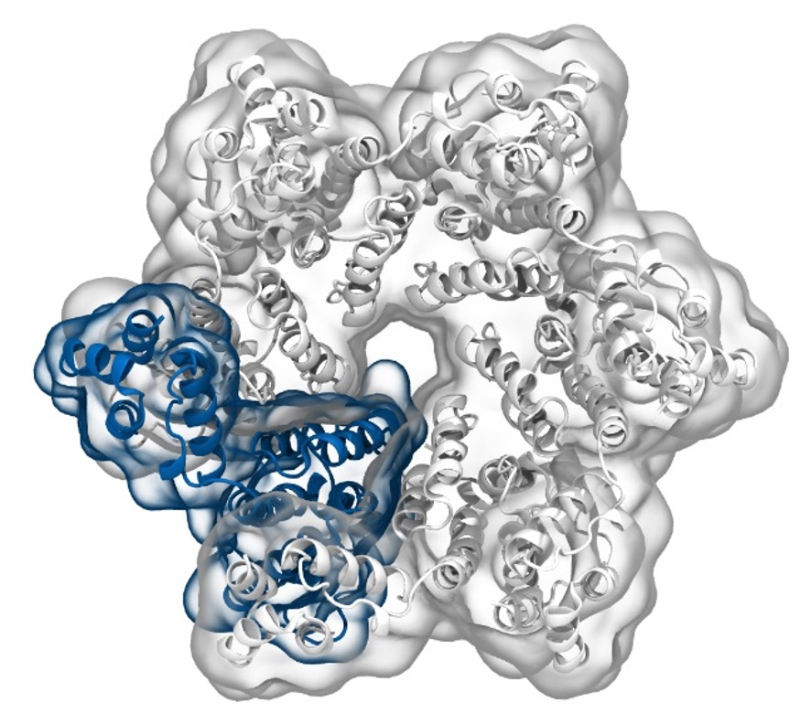
Simulation of Biomolecules
Dimensionality
Reduction
2024 CCP5 Summer School
Dr Matteo Degiacomi
Durham University
matteo.t.degiacomi@durham.ac.uk
Dr Antonia Mey
University of Edinburgh
antonia.mey@ed.ac.uk

Slide 2
Large ecosystem of Python-based tools data analysis
And many more…
2

Slide 3

The Data Mining world
From scikit-learn.org
3

Slide 4
The Data Mining world
From scikit-learn.org
4

Slide 5
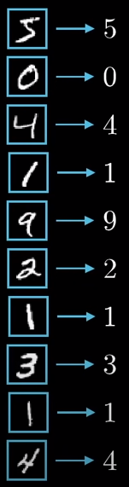
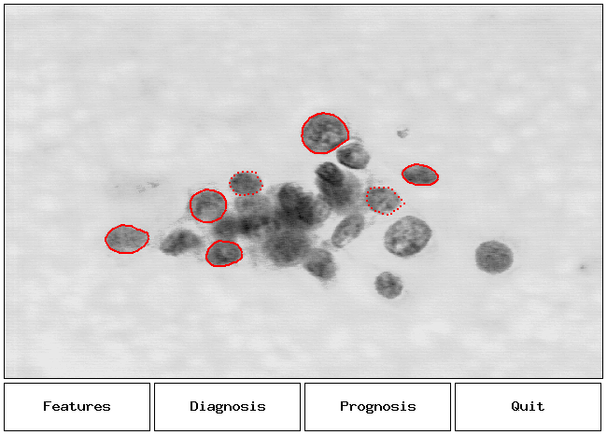
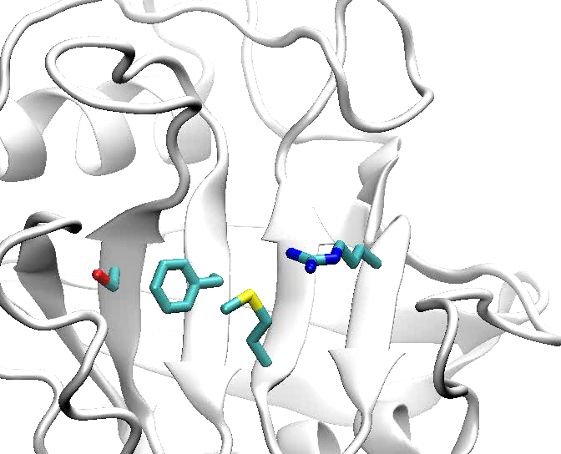
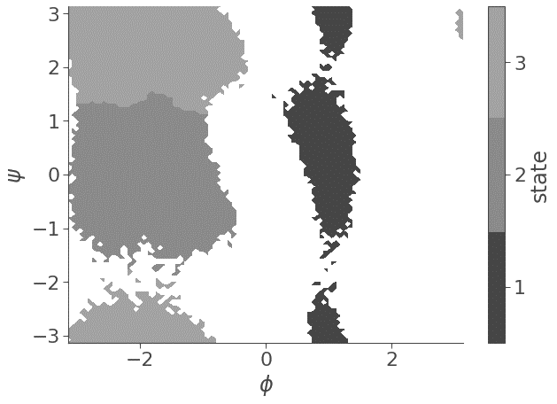
features are possible ways to represent data
φ
ψ
Sphericity (1)
Pixels colour
(28x28 = 784)
atomic positions (459)
atomic distances (3)
Torsional angles (2)

Slide 6

Not all features are useful
Task: predict the weather in Edinburgh
using historical data
data = {X, Y, Z} → sun, rain, snow
{Temperature (C),
Temperature (K),
Humidity (g/m³)}
{Temperature (C),
Swiss cheese export (£),
Humidity (g/m³)}
{Avg. gas expenditure (£),
Heat strokes (#),
Slipping accidents (#),
Sunscreen sold (£)}
2 decorrelated features
2 relevant features
4 features connected to another quantity temperature

Slide 7
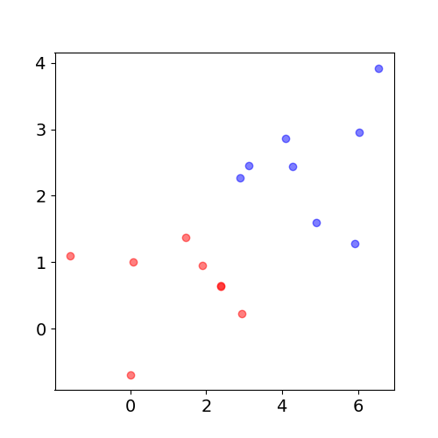
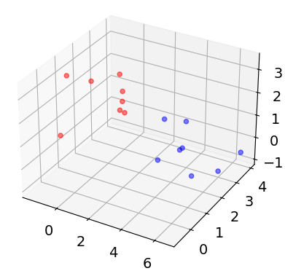
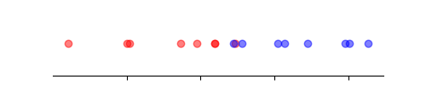
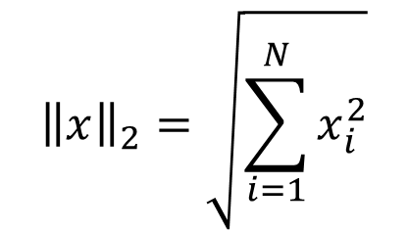

Curse of dimensionality
$${\left\|x\right\|}_{2}=\sqrt{\sum_{i=1}^{N}{x_{i}^{2}}}$$
Distances between M data points $x∈{\text{ℝ}}^{N}$increase, when N increases
Problem: less data density increases uncertainty on underlying data structure
Notes:
Dimensions of features
Statistical distribution
Euclidean distance (L2 norm)

Slide 8
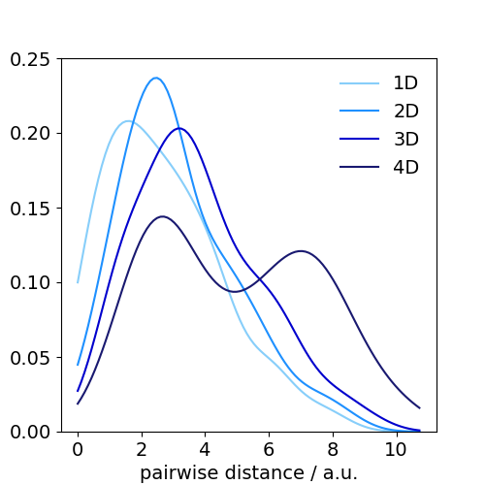
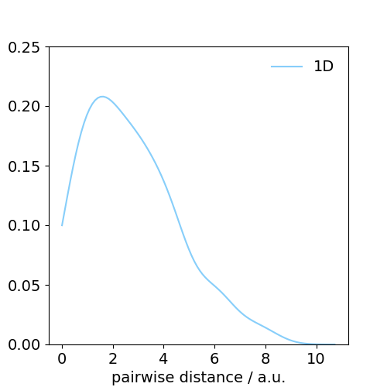
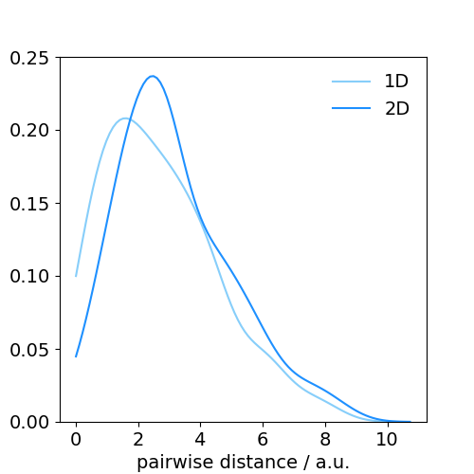
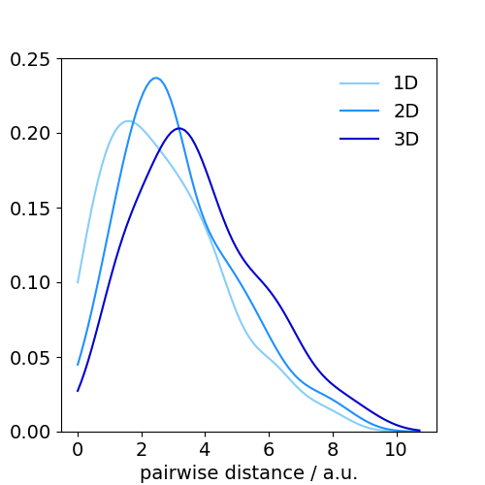
[Extra] Curse of dimensionality
Distribution of pairwise
distances between points
shown in previous slide
$${\left\|x\right\|}_{2}=\sqrt{\sum_{i=1}^{N}{x_{i}^{2}}}$$
Distances between M data points $x∈{\text{ℝ}}^{N}$increase, when N increases
Problem: less data density increases uncertainty on underlying data structure

Slide 9
Reducing features increases data density
Chose appropriate features [expert user]
Remove features
Find a lower dimensional representation E of features X
{ X₁ , X₂ , … , X_{N} }
{ E₁ , E₂ , … , E_{K} }
E_{i} = f({X})
where K < N

Slide 10
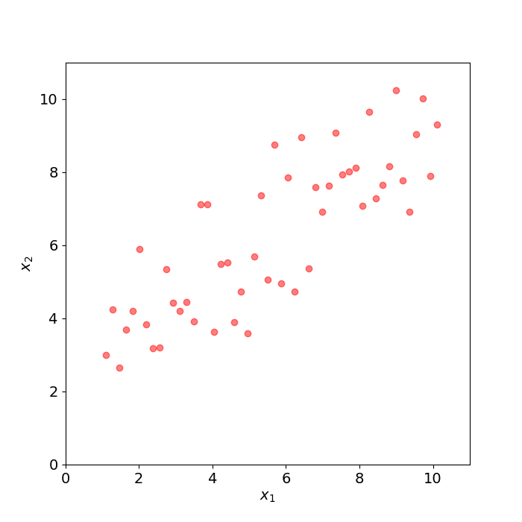
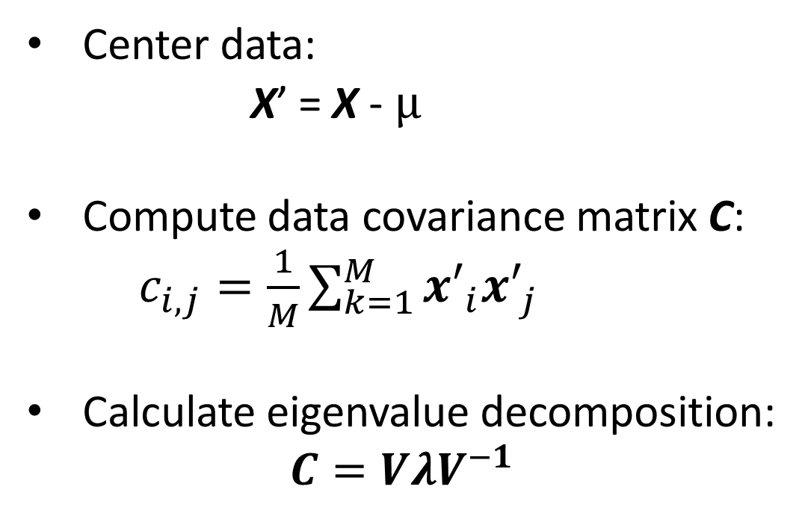
Principal Components Analysis (PCA)
Let X a dataset of M datapoints in N dimensions (here, M=50 and N=2)
Center data:
X’ = X - $µ$
Compute data covariance matrix C:
$c_{i,j}=\frac{1}{M}\sum_{k=1}^{M}{{x′}_{i}{x′}_{j}}$
Calculate eigenvalue decomposition:
$$C=VλV^{−1}$$
NxN matrix of eigenvectors
NxN diagonal matrix of eigenvalues
Notes:
Recall: all vectors are rotated by covariance matrix, but those in the direction of maximal data spread. Those are only scaled.

Slide 11



[Extra] Principal Components Analysis (PCA)
Let X a dataset of M datapoints in N dimensions (here, M=50 and N=2)
An eigenvector $v$ of $C$respects:
$$Cv=λv$$
Find eigenvalues as the roots of the characteristic polynomial:
$$p\left(λ\right)=det(C−λI)=0$$
The i-th eigenvector $v_{i}$is found by solving:
$Cv_{i}=$ $λ_{i}v_{i}$
Notes:
Recall: all vectors are rotated by covariance matrix, but those in the direction of maximal data spread. Those are only scaled.

Slide 12
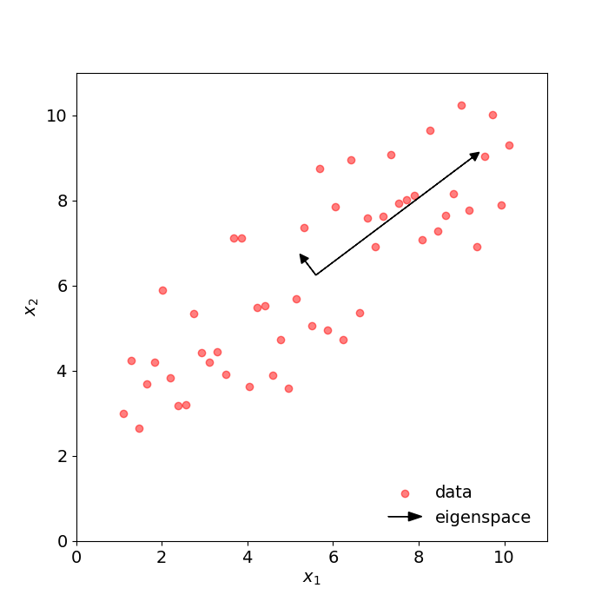


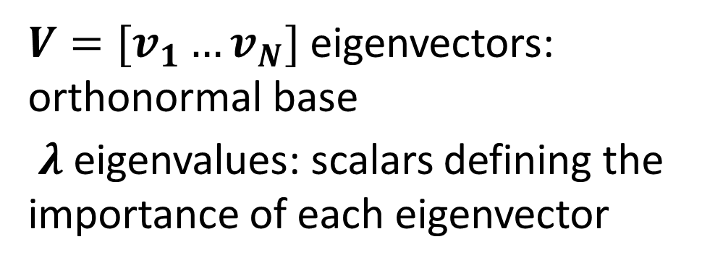
Principal Components Analysis (PCA)
Let X a dataset of M datapoints in N dimensions (here, M=50 and N=2)
$$C=VλV^{−1}$$
$V=[v_{1}…v_{N}]$ eigenvectors: orthonormal base
$λ$ eigenvalues: scalars defining the importance of each eigenvector
Importance $r_{i}$of each eigenvector $v_{i}$:
$$r_{i}=\frac{λ_{i}}{\sum{λ}}$$
Sort $V$ and $λ$ according to $λ$
Notes:
TALK ABOUT HOW EIGENVALUES TELL YOU HOW IMPORTANT AN EIGENVECTOR IS!
(link it to length of arrows in the plot)
Add worked example using data we have here?

Slide 13
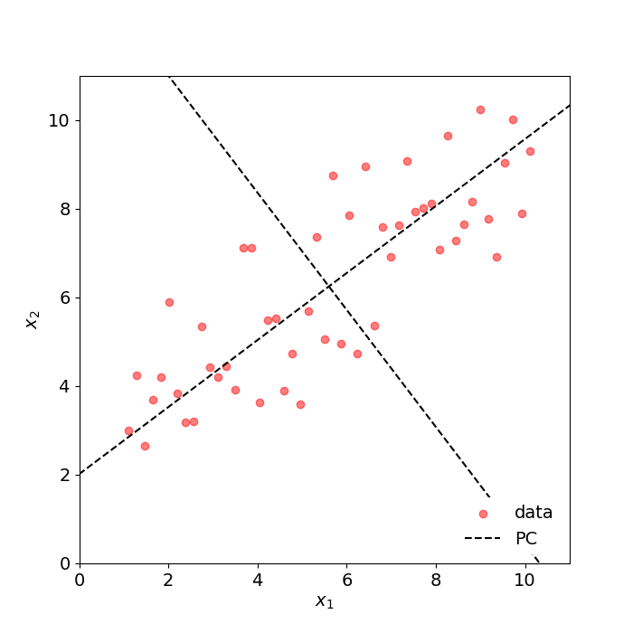
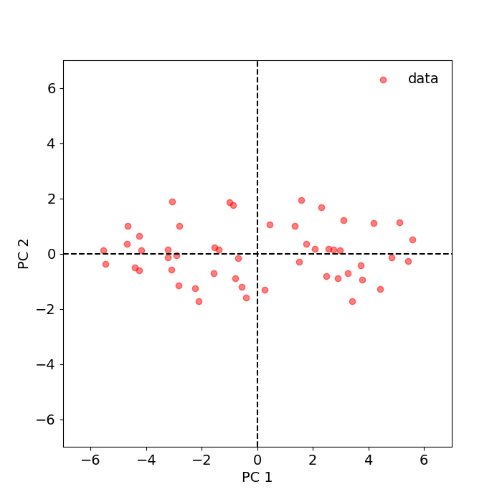
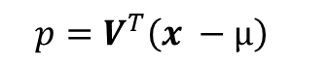
Projection into the eigenspace
Let X a dataset of M datapoints in N dimensions (here, M=50 and N=2)
$$p={V^{T}\left(x −µ\right)}^{}$$
transform
Notes:
CHECK EQUATION!
Feature ablation: remove features with least variance x’ = (x – mu)Tei, for I in 1..M

Slide 14
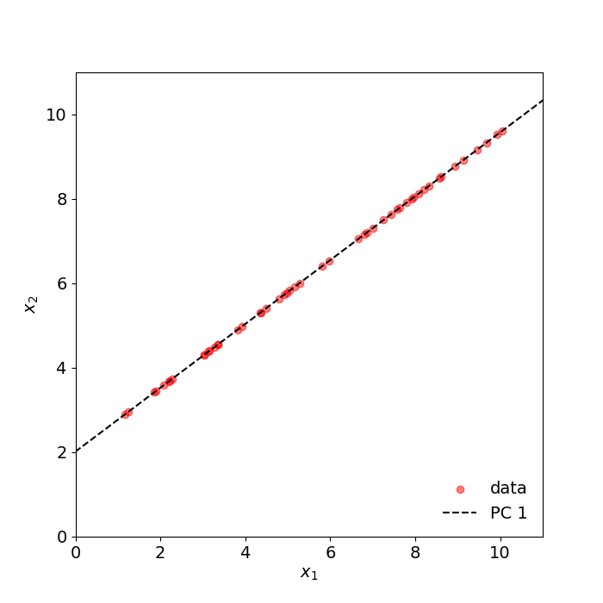
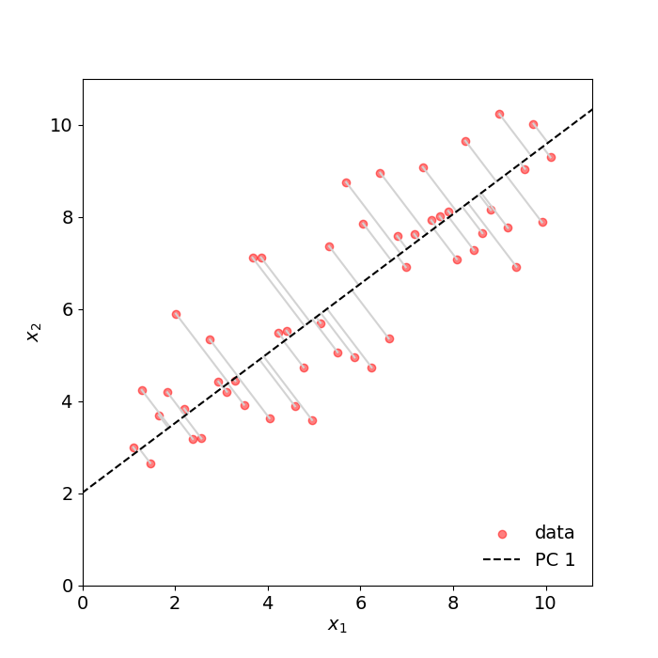
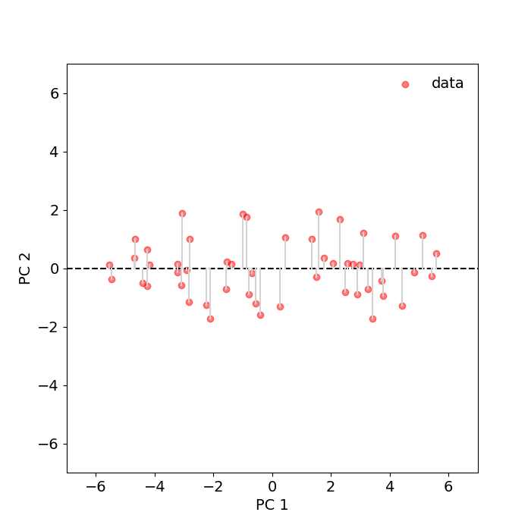
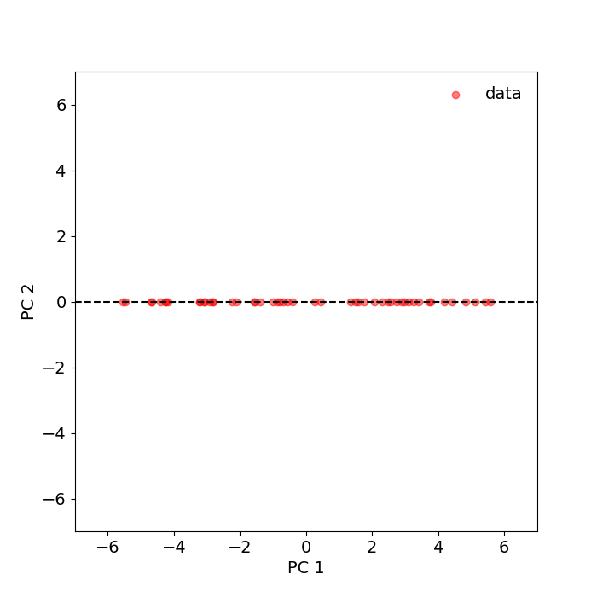
Dimensionality reduction
Remove dimensions that least contribute to data variance
$$p={V^{T}\left(x −µ\right)}^{}$$
transform

Slide 15
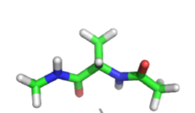
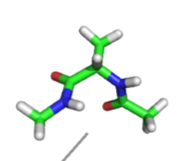
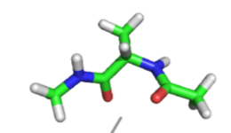
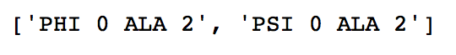
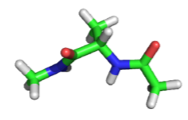
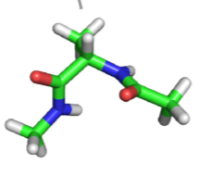
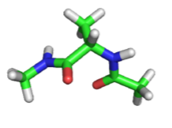
Dimensionality reduction for MD simulations
φ
ψ
ψ
ψ
Alanine dipeptide
φ
φ
15

Slide 16
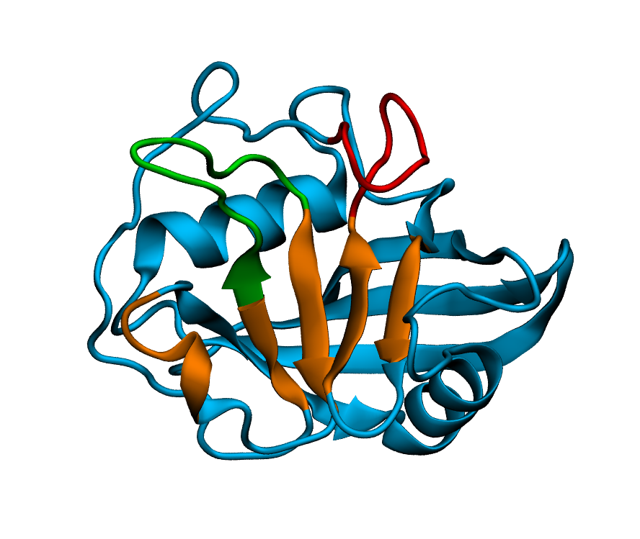
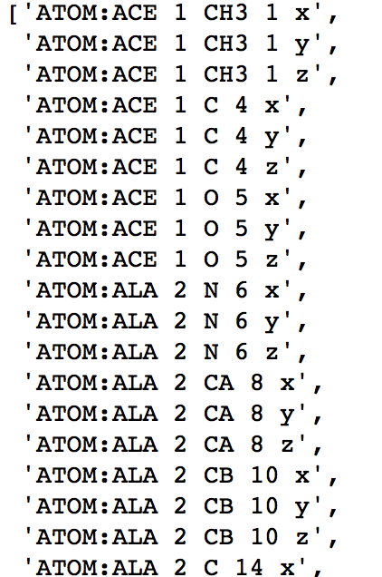
Dimensionality reduction for MD simulations
16

Slide 17
Dimensionality reduction — TICA, PCA, VAMP
Project features onto low dimensional subspace
PCA: Linear combination of input features maximising the variance
TICA: Linear combination of input features maximising time autocorrelation
VAMP: Variational approach for Markov Process, true for non-equilibrium data
VAMP: W. Chen et al., J. Chem. Phys., 2019
17

Slide 18
[Example 1] Representing written digits
MNIST database of written digits
2 principal components manage to project a few of the digits in a similar area of space!
Input is a vector of 64 dimensions 8x8 pixel digits
18

Slide 19
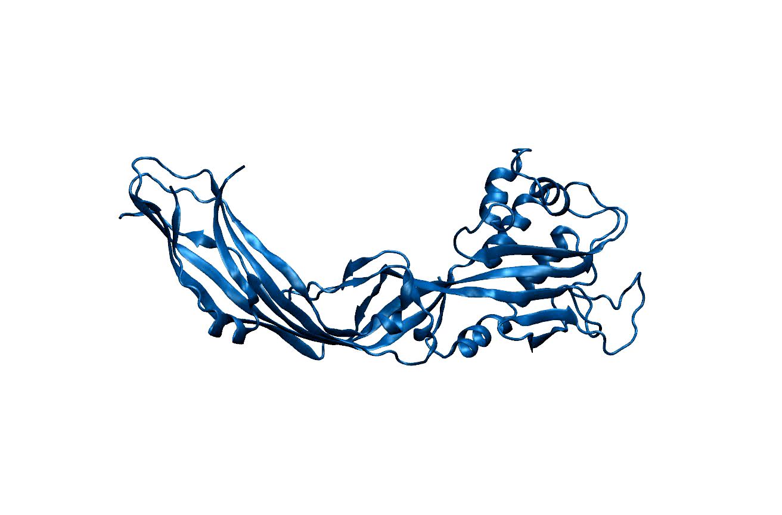
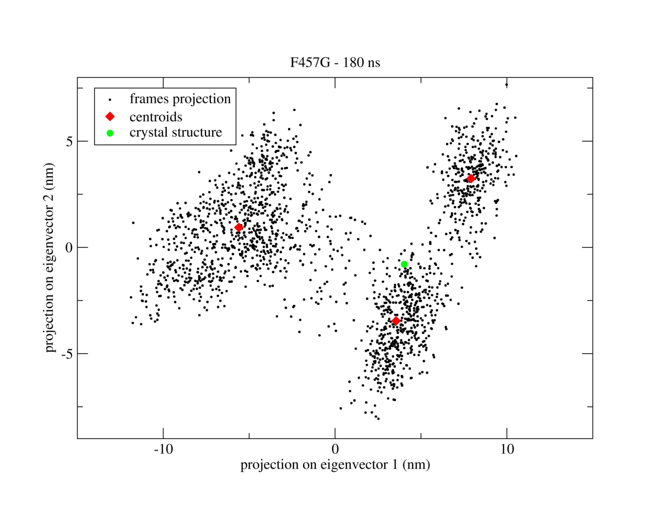
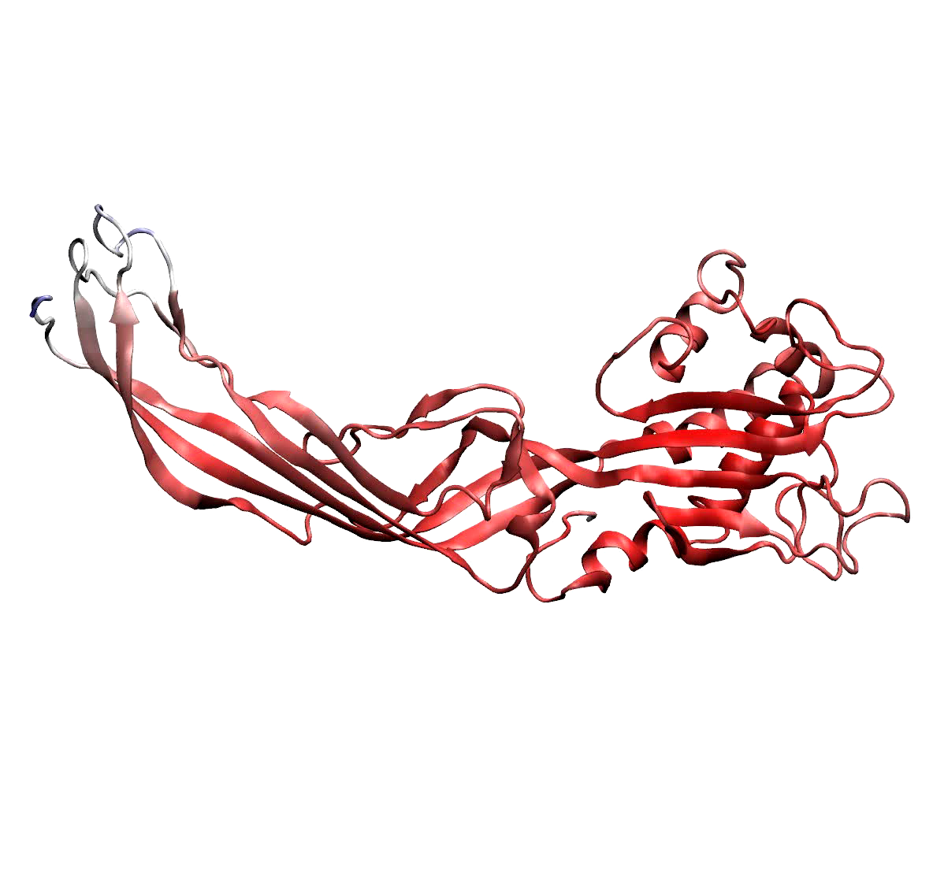
[Example] Identifying dominant motions in proteins
Protein MD simulation
Eigenspace of Cα coordinates
Simulations are complex and noisy
select only first few PC (eigenvectors) to separate signal from noise
19
Degiacomi, M.T. & Dal Peraro, M.. Macromolecular symmetric assembly prediction using swarm intelligence dynamic modeling. Structure, 2013

Slide 20
Time-lagged independent component analysis (tICA)
tICA is a linear transform similar to PCA
The transform is chosen such that, amongst all linear transforms, tICA maximizes the autocorrelation of transformed coordinates.
Thought experiment: typically hydrogen bond is considered established if donor-acceptor distance <2.5 Å, and donor-acceptor-hydrogen angle <20°.
bond
formed
50%
bond not
formed
50%
time
time
reporting % time a bond is established in simulation can be misleading!

Slide 21
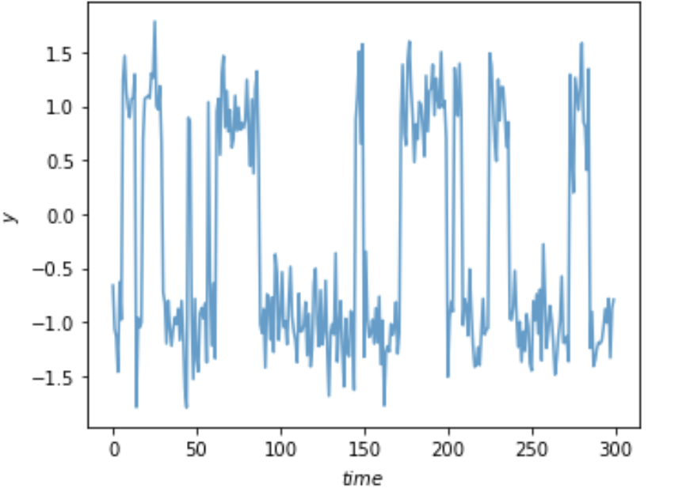
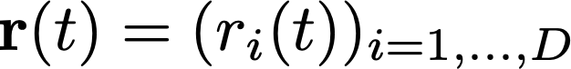
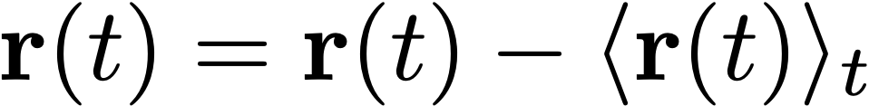
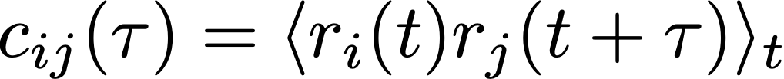

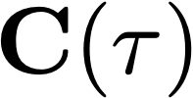
Time-lagged independent component analysis (tICA)
tICA is a linear transform similar to PCA
The transform is chosen such that, amongst all linear transforms, tICA maximizes the autocorrelation of transformed coordinates.
D-dimensional input data vector that is mean free, i.e.,
Computing the covariance of the data at
t = 0 and t = τ which is the lag-time chosen
enables computing two covariance matrices:
and
F. Nüske, […], A. S. J. S. Mey and F. Noé: JCTC, 2014
21
G. Perez-Hernandez, et al., JCTC, 2013
C. R. Schwantes et al., JCTC, 2013

Slide 22
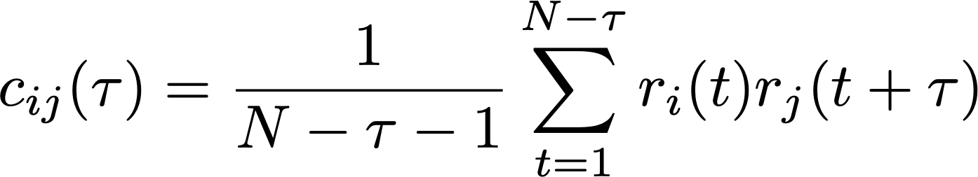
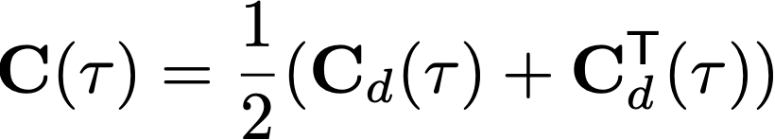

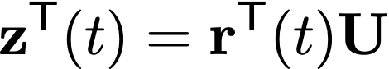
Time-lagged independent component analysis (tICA)
tICA is a linear transform similar to PCA
The transform is chosen such that, amongst all linear transforms, tICA maximizes the autocorrelation of transformed coordinates.
Entries of the covariance matrix can be computed as:
will be a symmetric matrix.
The symmetry of will need to be enforced with:
We can now solve the generalised eigenvalue problem:
Eigenvector matrix containing ICs
Diagonal matrix with eigenvalues
M columns of full rank U for DR
F. Nüske, […], A. S. J. S. Mey and F. Noé: JCTC, 2014
22
G. Perez-Hernandez, et al., JCTC, 2013
C. R. Schwantes et al., JCTC, 2013

Slide 23
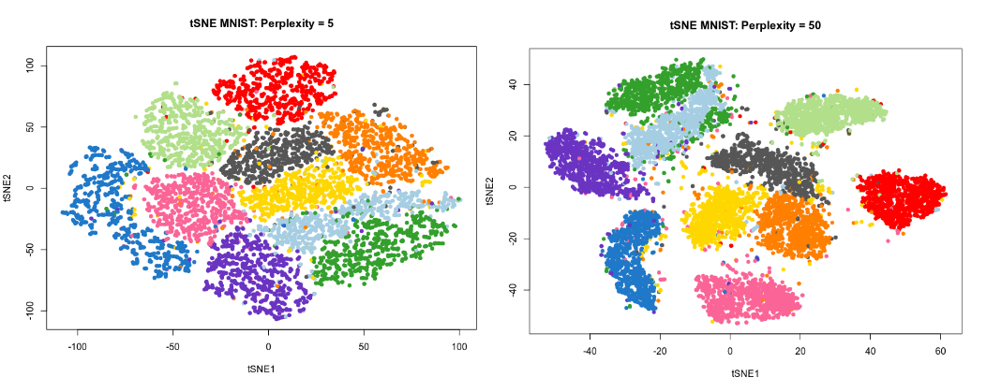
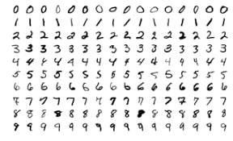
t-distributed stochastic neighbour embedding (t-SNE)
Useful for visualisation, project high-dimensional data in 2 or 3 dimensions.
Controlled by one main parameters: “perplexity”
Relative distance between points not quantitatively meaningful
MNIST: database of written digits
23

Slide 24
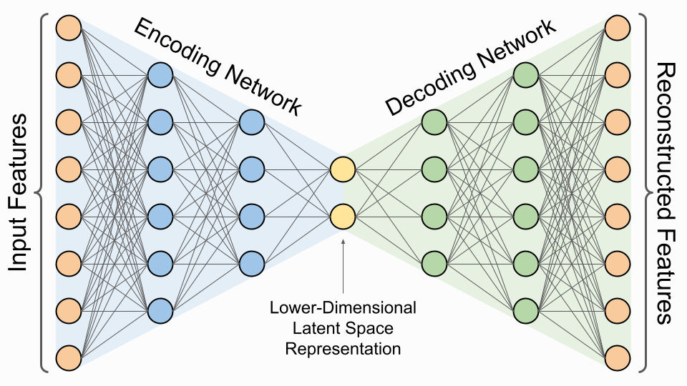
[Extra] Dimensionality reduction with neural networks
PCA dimensionality reduction is interpretable, that of t-SNE and neural networks is not.
24

Slide 25
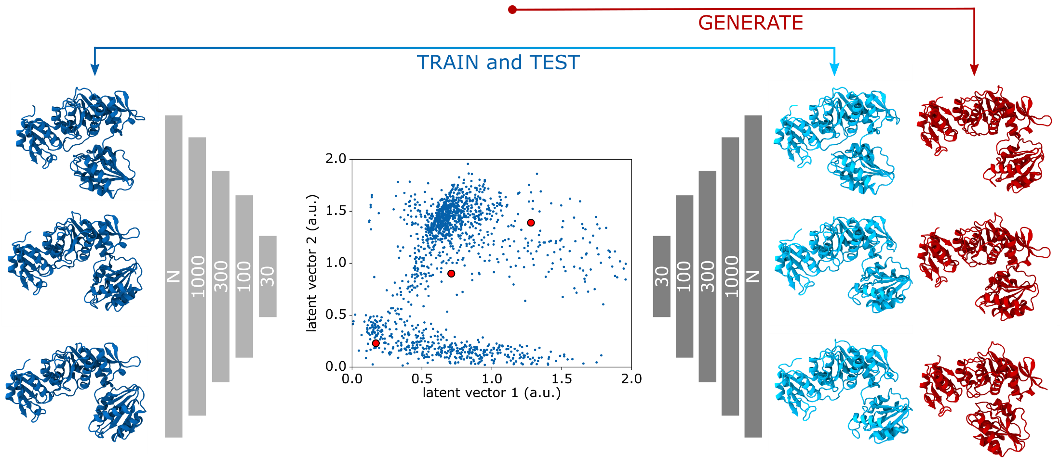
[Extra] Learning Protein Conformational Space
encoder
latent space
decoder
M.T. Degiacomi, Structure, 2019
25

